Slide 1


Employee Data Analysis using Excel
STUDENT NAME :DHIVYA.S
REGISTER NO :312209897(asunm1363312209897)
DEPARTMENT :B.COM BANK MANAGEMENT
COLLEGE :VALLIAMMAL COLLEGE FOR WOMEN
‹#›
Notes:
1

Slide 2



PROJECT TITLE
Employee Business unit Analysis using Excel
2

Slide 3



AGENDA
Problem Statement
Project Overview
End Users
Our Solution and Proposition
Dataset Description
Modelling Approach
Results and Discussion
Conclusion
3/21/2024 Annual Review
3

Slide 4
PROBLEM STATEMENT
Using excel helps to analyses employees data by leveraging
Function by PIVOT TABLES and CONDITIONS.
It shows the identification of key trends includes employee type, gender filter
Values for employees ID etc.,.
It helpful to make decision making process easier by the
visualization this data through pivot chart.
‹#›
Notes:
4

Slide 5
PROJECT OVERVIEW
This project focuses on analyzing employee data to identify trends and insights that can drive better decision.
Excel helps to collect, clean ,organize, and visualize the employee business units.
This project analysis highlights the number of employee in a every single business units.
The visualize is easy to separate the data through the gender filter.
The aim of this project to support the strategic planning
‹#›

Slide 6
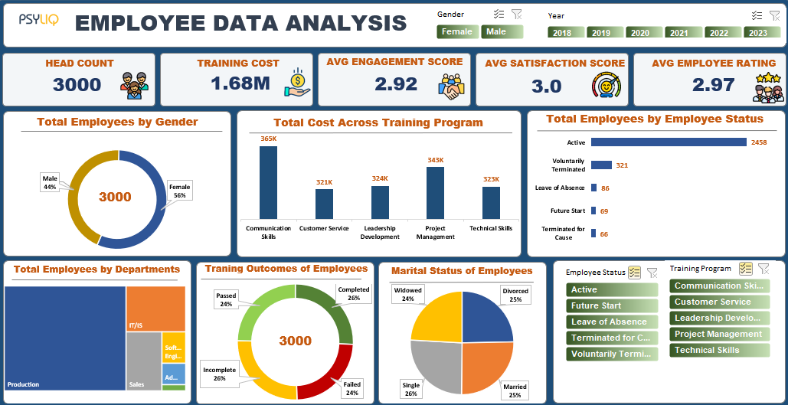
WHO ARE THE END USERS?
The end users of the employee data analysis are Human Resources MANGER
Leads and senior management.

Slide 7
OUR SOLUTION AND ITS VALUE PROPOSITION
CONDITIONAL FORMATTING --highlights missing cells
FILTER --helps to remove the empty cells
PIVOT TABLE --helps to summarize
PIVOT CHART --helps to visualize
‹#›

Slide 8
Dataset Description
Employee ID
Name
Gender
Department
Salary
Start date
FTE
Employee type
Work location

Slide 9
THE "WOW" IN OUR SOLUTION
CONDITIONAL FORMATTING :
That helps in filling the color in missing cells .
2.FILTER BY COLOUR :
That filter the missing cells by removing the colored cells.
3.PIVOT CHART :
That helps to visualize the data in simple way.
3/21/2024 Annual Review
9

Slide 10

MODELLING
DATA COLLECTION:
Identification
Gathering
Preparation
DATA CLEANING:
Standardization data
Correction
Validation
SUMMARY:
Data analysis involves examining ,transforming , and modeling data to extract insights, identify patterns and support decision-making skills.
10

Slide 11
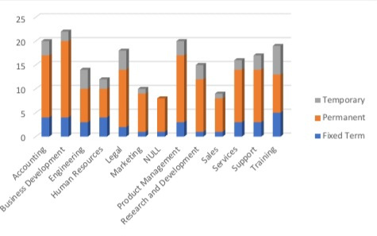
RESULTS: EMPLOYEE BUSINESS UNIT ANALYSIS
11

Slide 12
conclusion
In conclusion, the employee data analysis conducted using EXCEL
Provided valuable insights into workforce trends enabling more informed
Decision making.
The use of excel allowed efficient data organizing, visualizing and representing
The employee data , ultimately this data is helpful to enhance HR strategies, improve
employee information clear and helps for optimum performance

